Slide 1
Understanding and Using Terminology in HL7® FHIR®
Rob Hausam MD
HL7 FHIR Connectathon 27 Q&A on Implementing and Using FHIR Terminology and Terminology Services Part 1 – Introduction and Fundamentals

Slide 2

This presentation
Can be downloaded here:
https://github.com/FHIR/documents/blob/master/presentations/2020-11%20Webinars/FHIR%20Terminology%20-%20Part%201.pptx
Is licensed for use under the Creative Commons, specifically:
Creative Commons Attribution 3.0 Unported License
(Do with it as you wish – just give credit)
Acknowledgements: Grahame Grieve, Lloyd McKenzie
2

Slide 3
Who am I?
Name: Rob Hausam MD
Company: Hausam Consulting LLC
Background:
Co-chair of Vocabulary and Orders and Observations WGs
FHIR specification and Terminology Module editor
Actively involved in HL7 and terminology standards/development and modeling for 19+ years
SNOMED on FHIR project co-lead
Joint project of HL7 and SNOMED International

Slide 4
Tutorial Learning Objectives
Part 1 – Introduction and Fundamentals
Understand how coded data is represented in data types and model elements and is exchanged in FHIR resources
Understand how code systems and value sets in FHIR are defined, identified and used
Understand terminology binding and how to specify and use it correctly in FHIR models (resources and profiles)

Slide 5
Tutorial Learning Objectives
Part 2 – Searching and Services
Understand and use FHIR terminology-based search capabilities
Understand and use FHIR Terminology Service capabilities

Slide 6
Part 1 Topics Introduction and Fundamentals
Where to Find Terminology in FHIR
Representing Coded Data in FHIR
Code
Code System
Value Set
Terminology Binding
Coded Data Types

Slide 7
Part 1 Topics Introduction and Fundamentals
Primary FHIR Terminology Resources
CodeSystem
ValueSet
More FHIR Terminology Resources
ConceptMap
NamingSystem
TerminologyCapabilities

Slide 8
where to find Terminology in FHIR

Slide 9
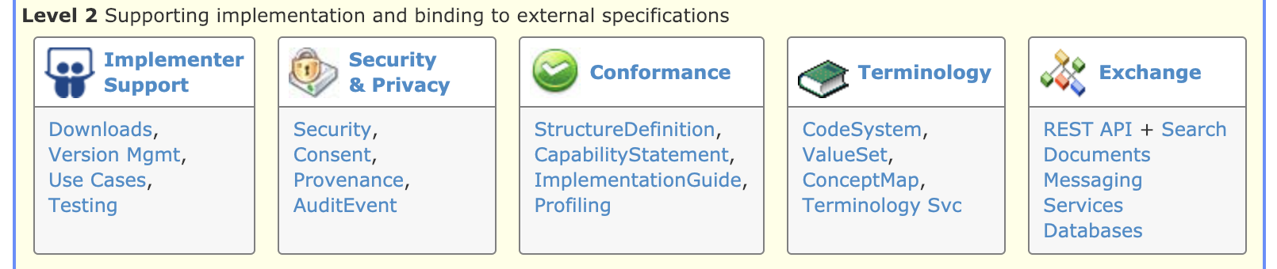
Terminology Module
Level 2 on the Home page
The primary organizing place in the FHIR specification for terminology specifications, guidance and content
http://hl7.org/fhir/terminology-module.html

Slide 10
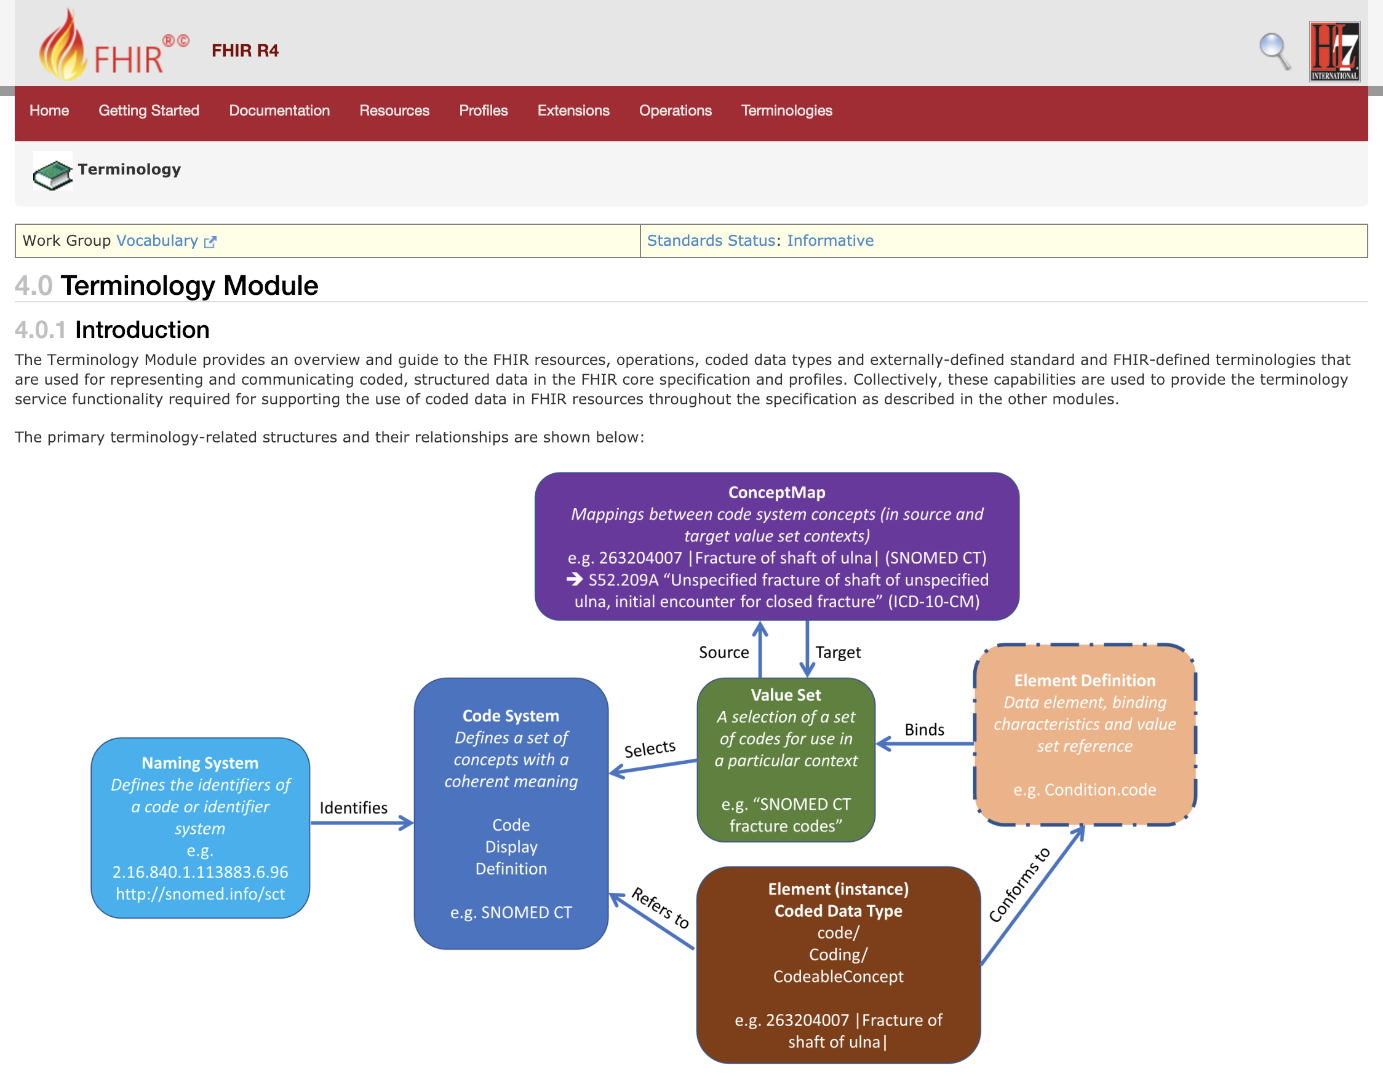

Slide 11

Terminologies link
Terminologies link
The last link on the right in the top-level (red) navigation bar
The quick and easy way to get to the terminology content in the FHIR specification – code systems, value sets, concept maps

Slide 12
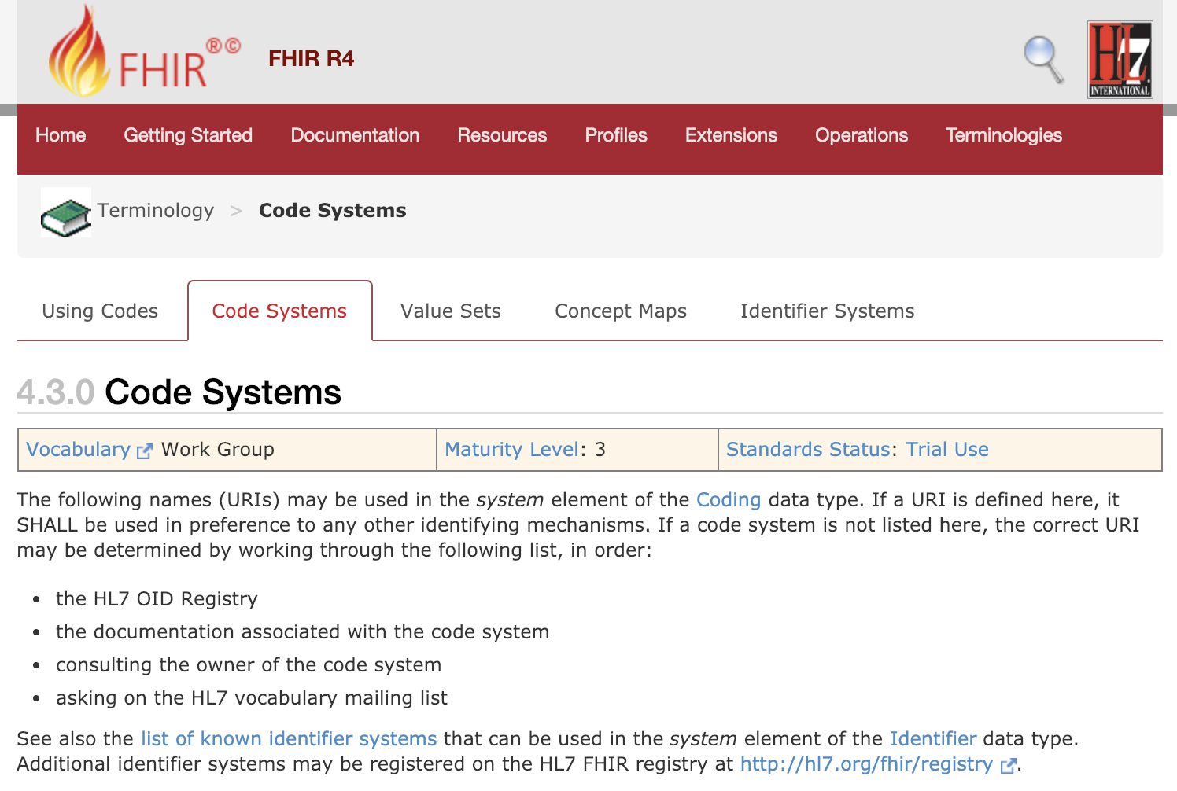

Slide 13

FHIR Zulip chat Terminology stream
https://chat.fhir.org/#narrow/stream/terminology

Slide 14
Representing Coded Data in fhir

Slide 15
Let’s Start with a Code
A code is a symbol used to represent a specific meaning or idea (i.e. “concept”)
195967001 = “Asthma (disorder)” (SNOMED CT)
fhir-structure = “FHIR Structure” (FHIR ‘definition-use’)
Ideally it “should” be a meaningless identifier, but FHIR chose (semi) meaningful codes (implementer friendly)
No separate ‘Code’ resource currently exists in FHIR (but it is being discussed)

Slide 16
Code System
Code System
Defines a set of concepts with a coherent meaning Code Display
Definition
e.g. SNOMED CT
SNOMED CT / LOINC / ICD-10
RxNorm, NDF-RT, ICPC, ICF, CPT, CVX, NUCC HCPT, ATC, ANZSCO (+ 100s more)
HL7 V2 tables, V3 code systems
A drug formulary
Options for a config table in an application
A list of enums in a java class
Country codes (ISO 3166)

Slide 17
Value Set
Value Set
A selection of a set of codes for use in a particular context
e.g. “SNOMED CT fracture codes”
Code System
Defines a set of concepts with a coherent meaning Code Display
Definition
e.g. SNOMED CT
Selects
“European country codes”
“The LOINC codes that I use”
All LOINC order codes
A particular SNOMED CT hierarchy
Substance codes plus “No known allergy”

Slide 18
Code System vs. Value Set
Why do we need both?
These can be mixed (and misunderstood) in common usage
Especially for a value set that is “all codes” from the code system
A value set can contain codes from more than one code system
But it’s usually not a great idea
Separate the definition of a concept (code system) and the use of a concept (value set)
Keep this straight to avoid getting into trouble when you exchange data
18

Slide 19
Code System vs. Value Set Take Home Points
Code systems define symbols with specific meanings
E.g. LOINC, SNOMED, ICD-10, IETF language codes, local lab result codes, etc.
Value sets define collections of codes for use in a particular context
E.g. Codes for vital signs, codes for procedures
Can come from a single code system or multiple code systems

Slide 20
Terminology Binding
Value Set
A selection of a set of codes for use in a particular context
e.g. “SNOMED CT fracture codes”
Element Definition Data element, binding characteristics and value set reference e.g. Condition.code
Code System
Defines a set of concepts with a coherent meaning Code Display
Definition
e.g. SNOMED CT
Selects
Binds
20

Slide 21
More on Bindings
Bindings identify the codes that are allowed to be used for a given element
Bindings can be to a:
Value set
By convention a binding is to a value set – not directly to a code system
Reference (to an “inferred” value set)
E.g. Mime types
Description only
This must be populated if no reference is available

Slide 22
Binding Strength
example: These codes just give an idea of what you might use
No expectation (or recommendation) of use
preferred: You SHOULD use the specified codes
But if you have a good reason, you can use something else instead – it is not required to use the specified codes in order to be conformant
extensible: You must use the specified codes if they apply
Free to use other codes or text if the value set doesn’t cover the concept
required: You must use the specified codes
Or omit the element if no code applies for the concept

Slide 23
Coded Data (instance)
Value Set
A selection of a set of codes for use in a particular context
e.g. “SNOMED CT fracture codes”
Element Definition Data element, binding characteristics and value set reference e.g. Condition.code
Code System
Defines a set of concepts with a coherent meaning Code Display
Definition
e.g. SNOMED CT
Selects
Binds
Element (instance)
Coded Data Type code/ Coding/ CodeableConcept e.g. 263204007 |Fracture of shaft of ulna|
Conforms to
Refers to
No reference from a coded data instance directly to a value set (except by the valueset-reference extension)
23

Slide 24
Binding vs. Data element instance
A binding specifies a value set
Observation.code is bound to:
valueSetReference = http://hl7.org/fhir/ValueSet/observation-codes
Definition of ‘observation-codes’ = “This value set includes all LOINC codes”
A data element instance specifies a code system
Observation.code.coding.system = http://loinc.org
Observation.code.coding.code = 15074-8
Observation.code.coding.display = Glucose [Moles/volume] in Blood

Slide 25
Referring to a code system
Each “use of a code” (a reference into a code system) has 4 properties:
system: URL of the code system
version: stated version of the code system (optional)
code: the symbol defined for the concept (code/expression)
display: a human readable representation of the concept (optional – primarily for debugging/display)
25

Slide 26
URL vs. Object Identifier (OID)
In v2, you could identify code systems (and identifier systems) in a variety of ways
typically a local string
In v3 you had to use OIDs
E.g. 2.14.1237.937.25.58
In FHIR, we use URLs
E.g. http://myhospital.org/codes/labresults
Can also use urn:oid:2.14.1237.937.25.58
If you really want to ☺
Human-readable
Potentially resolvable
No training required

Slide 27

The ‘code’ Data Type
Just a code
Code system is fixed
Value set is fixed (required binding)
Display name is known
Used for “structural” elements
Essential to fundamental interoperability
Reasonable to standardize at international level
E.g. ‘status’, ‘Bundle.type’, etc.

Slide 28
What if I need a different ‘code’?
‘code’ data elements aren’t extensible
Can’t send your own custom codes
If coded element is optional
Omit the element and just send an extension
If coded element is minOccurs=1
Choose the code closest matching your need
Send additional semantics as an extension
Consider submitting a change request for inclusion in a future version of FHIR

Slide 29

Coding
code + system
Not often used directly
Example: Consent.purpose
In most cases, if you need one Coding, you probably also need translations and/or original text ➔CodeableConcept
Question: Why is everything optional?

Slide 30
Coding – Element Optionality
Version, display and userSelected provide additional optional information
System is present with no code
Means there is no suitable code in the system which can be used to represent the concept
Only the code is present (and not the system)
Could occur, but rare and best avoided
Must be able to infer the system by context or no useful processing can be performed

Slide 31

CodeableConcept
Potentially multiple ‘Coding’ elements, all are “equal”
One can be “user selected”
Coding.userSelected (boolean)
To maximize interoperability, send all of the Codings that you know
Text: Representation of the concept as entered or chosen by the user
Text and Coding.display are fallbacks for systems that don’t recognize your code, so it is good practice to include them

Slide 32
What to use for coded data in an extension?
The default is CodeableConcept – it’s the safest for subsequent migration and interoperability
Use Coding only if translations don’t make sense (not just if you don’t currently have a need)
Use ‘code’ if (and only if):
It is essential that everyone use the same codes
You can define a set of codes that sufficiently cover the space

Slide 33
Codes vs. Identifiers
Coding
code
system
display (for code), version, primary, valueSet
Represents a meaning/concept
Can cover real things such as countries, states
Identifier
value
system
label (for system), use, period, assigner
Represents an “identity”, but can also identify a “kind”

Slide 34
primary terminology resources
34

Slide 35
CodeSystem
Declares the existence of a code system and its key properties:
Identifying URL and version
Description, copyright, publication date, and other metadata
Whether case sensitive and version safe
Whether a compositional grammar is defined
Filters for use in a ValueSet.compose element
Code system-defined concept properties

Slide 36
CodeSystem
May list some or all of the concepts in the code system, along with their basic properties (code, display, definition), designations, and additional properties
Not intended to support the process of maintaining a code system
Not intended for distributing important existing (large) code systems (e.g., SNOMED CT, LOINC, RxNorm, ICD family, etc.)

Slide 37
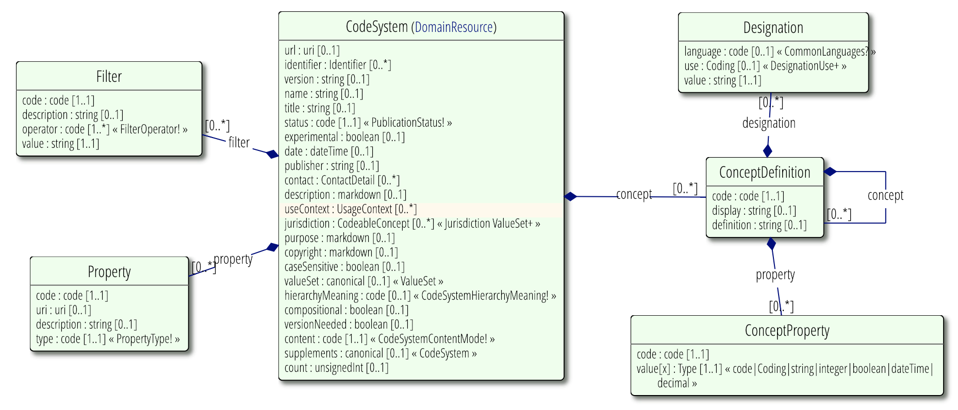
CodeSystem (UML)
Changed data type to ‘canonical’ in R4
Added code system ‘supplements’ in R4 – a reference to an additional code system used to “supplement” the primary code system with additional properties, descriptions, etc.

Slide 38
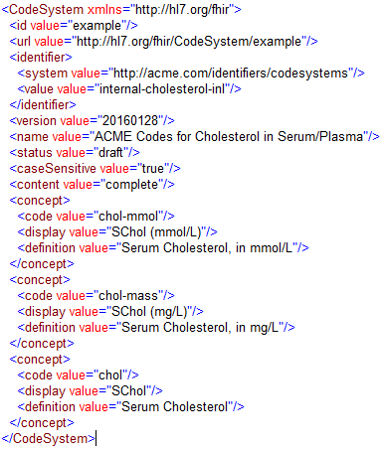
Code system definition example

Slide 39
ValueSet
Value sets use CodeSystem resources by referring to them via their canonical URLs
Value sets are used in ElementDefinition and Questionnaire resources to specify the allowable contents for coded elements
Aligned with Value Set Definition (VSD) spec
Not all VSD elements are in the base resource
Some are defined as part of ValueSet extensions
ValueSet.compose = VSD "Content Logical Definition” (CLD)

Slide 40
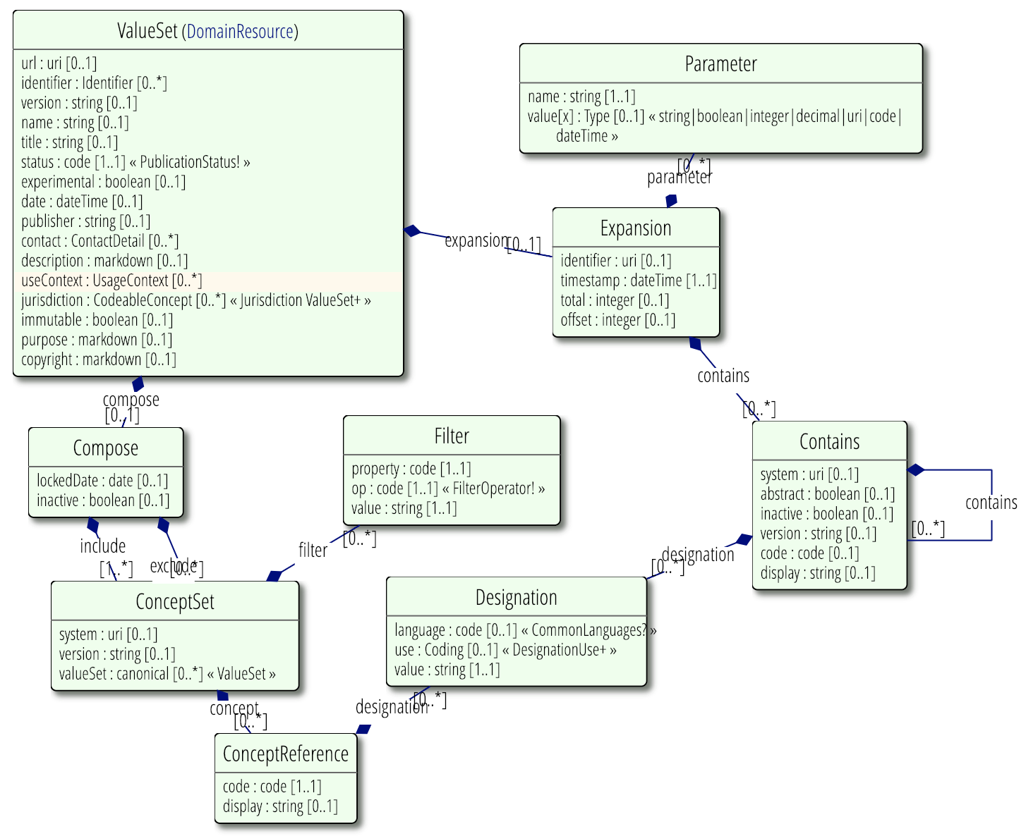
ValueSet (UML)
Changed data type to ‘canonical’ in R4

Slide 41
Value Set Parts
Meta data
url, identifier, version, name, title, status, experimental, date, publisher, contact, description, useContext, jurisdiction, immutable, purpose, copyright, extensible
Logical definition (.compose):
Codes to include/exclude – by system, list or filter
Specify other value sets to include/exclude
Expansion (.expansion)
What’s actually in the value set today, under local conditions

Slide 42
Value Set Versions
Versions are important to understand and use, when needed
A value set that doesn’t use ValueSet.compose.include.version has unknown content (even if it lists the codes explicitly)
If you don’t decide on a version, the decision and the results are delegated to run time
But, this is a very common thing to do
42

Slide 43
Selecting Concepts
Name the code system (‘system’, with optional ‘version’)
If just a ‘system’, then all codes are included
List codes
Can provide alternate descriptions
Select codes by property (‘filter’)
Property Name – defined by the code system
Operation – ‘=’, ‘is-a’, ‘in’, ‘regex’, etc.
Value – the value of the property
e.g., LOINC: COMPONENT = “Sodium”

Slide 44
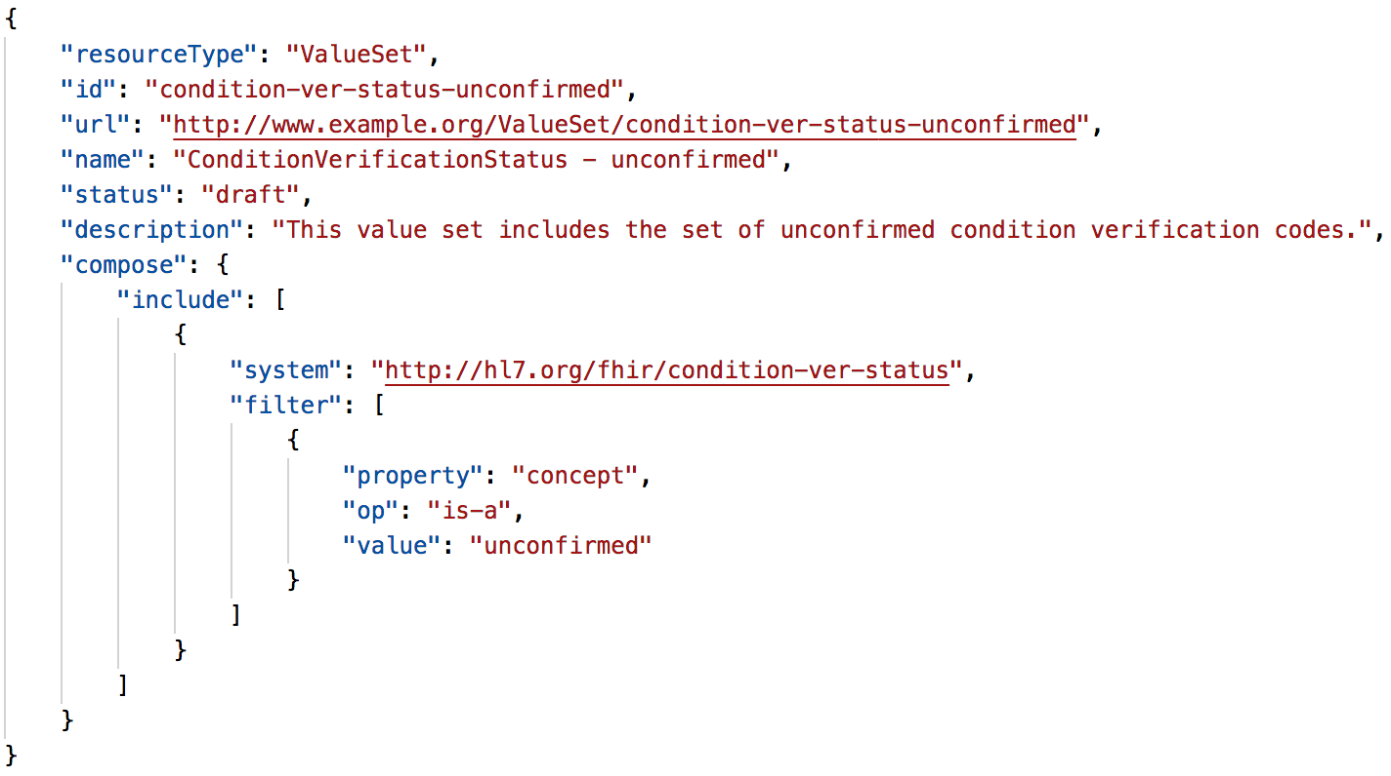
Compose example

Slide 45
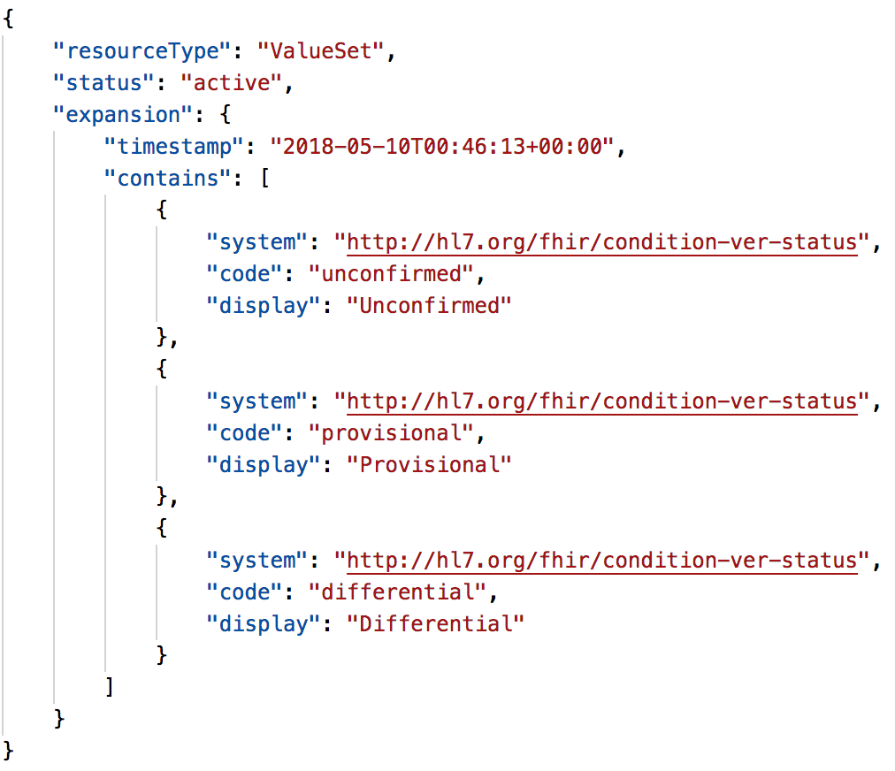
Expansion example

Slide 46
More terminology resources

Slide 47
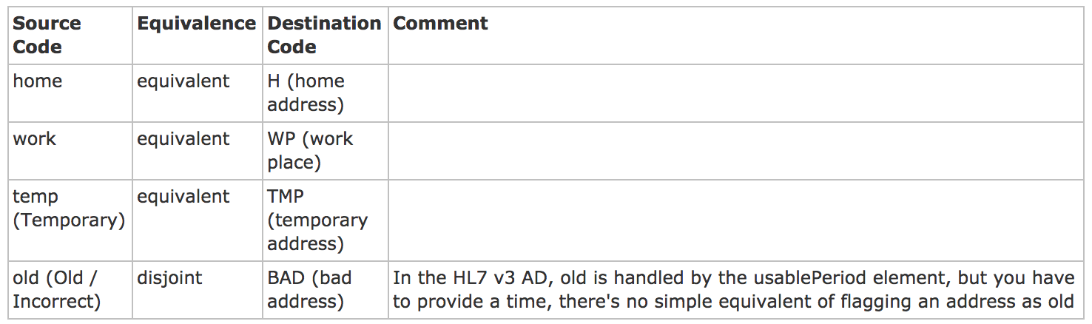
ConceptMap
A list of mappings between concepts from two different value sets (normally from different code systems or models)
Mapping data for the $translate operation (more on this later)
A mapping between the FHIR and HL7 v3 AddressUse Code systems

Slide 48
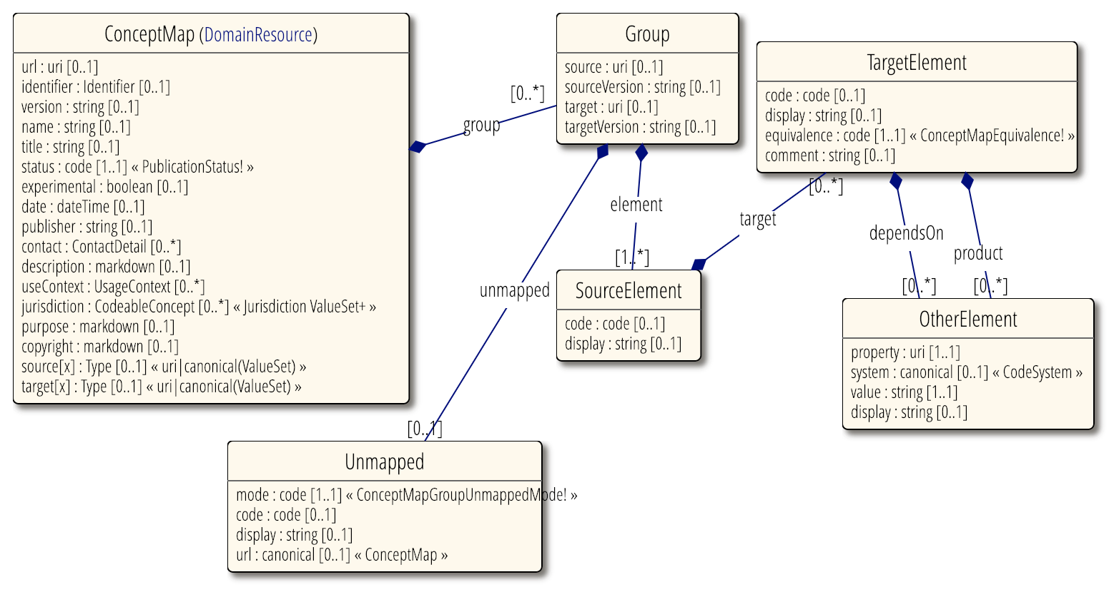
ConceptMap (UML)

Slide 49
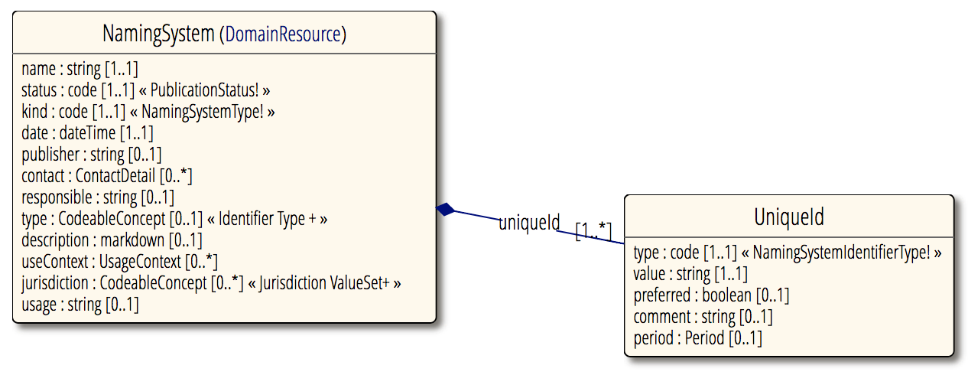
NamingSystem
Identifies the existence of a code or identifier system
Typically defined by 3rd parties (other than the code or identifier system "owner”)

Slide 50
TerminologyCapabilities
Provides the ability for a terminology server to describe the details of what the terminology service supports
Resource added in R4 (draft – FMM 0, FMM 1 in R5)
In addition to the overall server capability statement (CapabilityStatement resource)
Server ‘/metadata’ endpoint
Return server terminology capabilities
GET [base]/metadata?mode=terminology

Slide 51
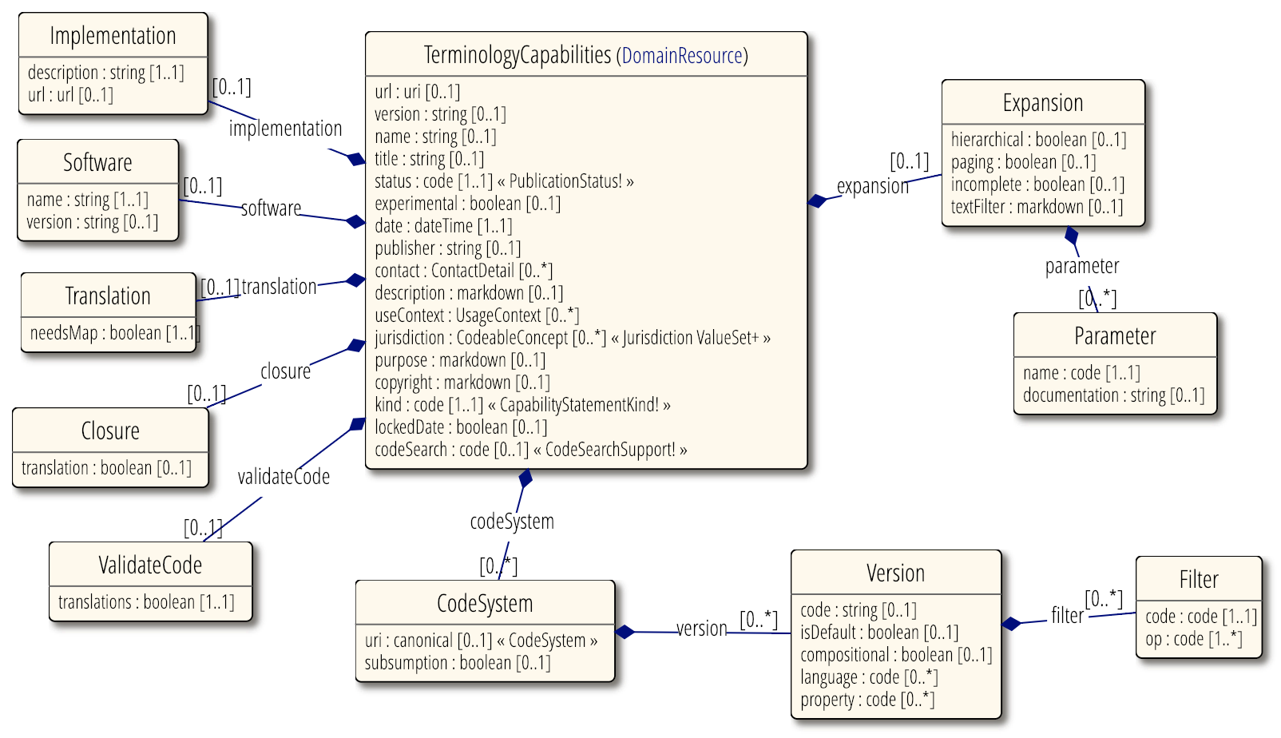
TerminologyCapabilities (UML)

Slide 52
What Are Your Questions?

Slide 53
More Questions?
Connect with the FHIR community: FHIR Zulip chat terminology stream
https://chat.fhir.org/#narrow/stream/terminology
Or ask me: Rob Hausam
rob@hausamconsulting.com

